Slide 1
Functions
Mohammad Salman
Dean’s Fellow

Slide 2
Function Declarations and Definitions
Functions can be declared?

Slide 3
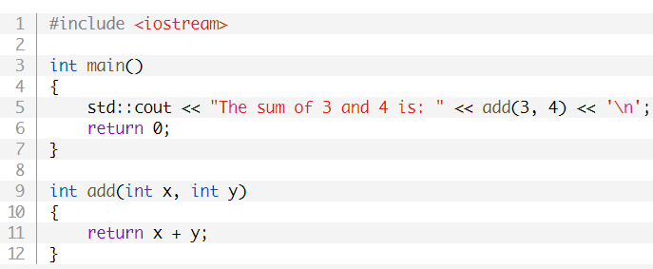
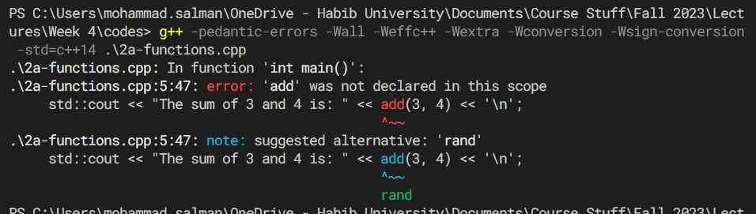
Function definitions should come before defining main().
Otherwise, compiler complains.

Slide 4
Function Definitions before main()
Compilers, for the most part, scan your code from top to bottom.
So the function definition hasn’t been seen before the function is called.
Call is in main().
Definition is after main().
Therefore, an error is raised.
That is why we have been keeping the definitions before main().

Slide 5
Function Definitions before main()
However, in larger programs, performing this rearrangement can be difficult.
Sometimes it may be impossible to rearrange your functions in a way that definitions come before calls to them.
Example on next slide.

Slide 6
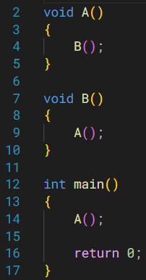
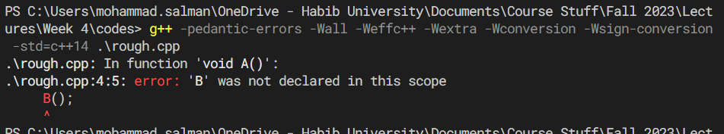

Slide 7
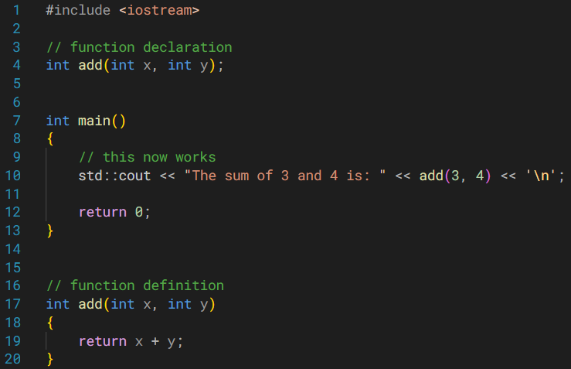

Make use of function declarations!

Slide 8
Function Declaration (or Function Prototype)
A function declaration tells the compiler that a function exists.
And we will provide the definition somewhere else.
And you must! Otherwise errors.
This puts the compiler at ease.
So now, you could have a function definition that is present,
after main(), or,
even in some separate file.

Slide 9
Function Declaration (or Function Prototype)
The function declaration consists of the following.
Function’s return type
Function’s name, and
Function’s parameter types
A semicolon at the very end.
int add(int x, int y);
The function body is not included in the declaration.
This idea is referred to as forward declaration.
The compiler is made aware of the existence of a function before defining it.

Slide 10
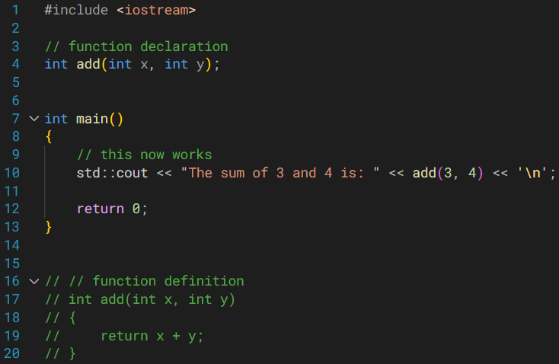
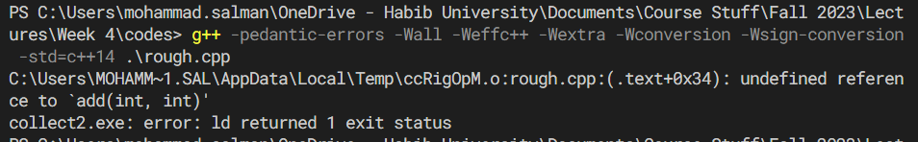
This is the error that you get if you forget to provide the function definition.
You’ve failed to fulfil the promise you made to the compiler.

Slide 11
Organization of Source Code
You have already seen in your homeworks how big programs are organized into multiple .cpp files (and .h or .hpp files).
Splitting your source code into multiple files allows for better organization and software management.
What we just saw enables this.

Slide 12
Organization of Source Code
So you will have something like this.
Going to the code editor.

Slide 13
Organization of Source Code
In order to compile multiple source files using your terminal, we can do the following.
You can add all other flags/options as well.
g++ main.cpp add.cpp -o main
This ends up being the name of your executable.
If you don’t use this, you will get a.exe.
These are all your .cpp files with all your source code that you need to compile.

Slide 14
Organization of Source Code
If you want to compile all of your source files, then knowing about this shortcut could be helpful.
g++ *.cpp -o main
Code editor…
The asterisk indicates that you want to compile all files that end in .cpp

Slide 15
Preprocessor Directives
There are many.
An example is #include
Copies the contents from the specified file and pastes it into the file where you have used #include.
#include <header_file> or,
#include ”header_file”
Use angle brackets when the file is built-in, or from a third-party.
Use double quotes when you have created your own header file.

Slide 16
Header Guards
Ensure that the contents of a given header file are not copied more than once into any single file.
This is to prevent duplicity of code, and this has many other benefits.
Have these guards in your header files (.h).
#pragma once

Slide 17
Header Guards
You can also use the following in your header file.
#ifndef MULTIFILE_ADD_H // some unique name
#define MULTIFILE_ADD_H
// Contents of your header file
int add(int x, int y);
#endif

Slide 18
Header Guards
You will understand its importance, specifically, when you start working on your projects.

Slide 19
Function Overloading
Functions can have the same name…

Slide 20
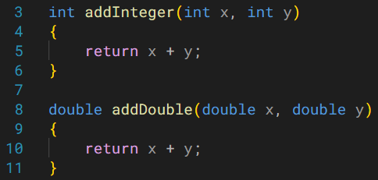
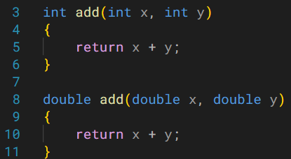
You may need more functions that do a very similar task.
The problem is that you will have to come up with a consistent naming scheme, which can be a pain.
Function overloading allows you to use the same function name.
There must be some uniqueness, so that the compiler could differentiate between the functions with same names.

Slide 21
Function Overloading
Note
For function overloading, the name becomes the same. So the compiler uses other parts to distinguish b/w overloads.
How to ensure uniqueness so that the compiler could differentiate?
Function’s Type Signature (or Signature)
Name of the function.
Number of parameters.
Data types of parameters.
One more thing (don’t worry for now).
Return type of a function is not part of the function signature.

Slide 22
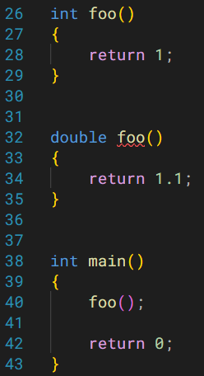
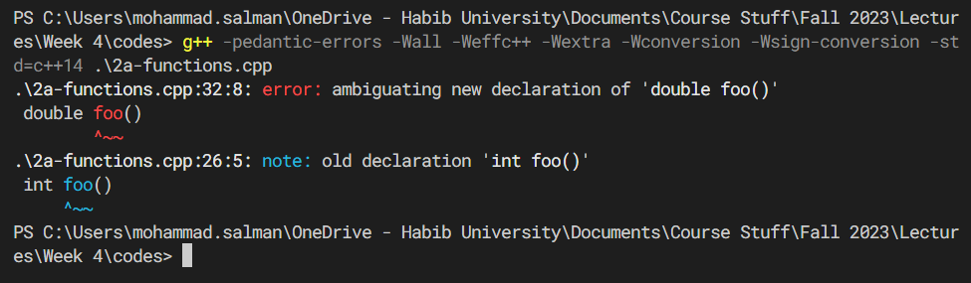
Return type of a function is not part of the function signature.
It isn’t clear which function should the compiler call.
In this case, you might just want to have different function names.
int fooInt()
double fooDouble()

Slide 23
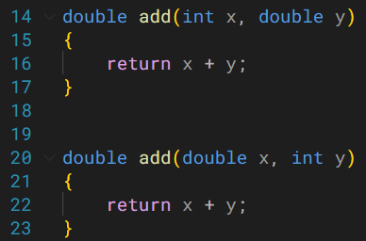
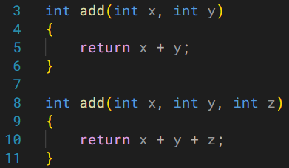
Varying the number of parameters.
Varying the list of parameter types.

Slide 24
Default Arguments

Slide 25
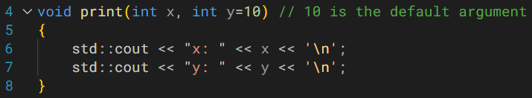
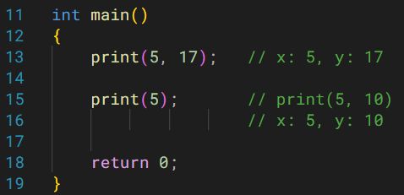
Default Arguments
A default value of 10 has been set for y.

Slide 26
In order to call this function, two arguments could be provided.
However, I may choose to not pass a value for y, since a default value has been specified.
So I can pass one value for x only.
If I don’t pass a value for y, it will have a value of 10 (value of default argument).

Slide 27
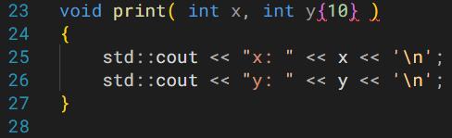
NOTE ON SYNTAX
Braces will not work for default arguments.
Have to use
int y = 10

Slide 28
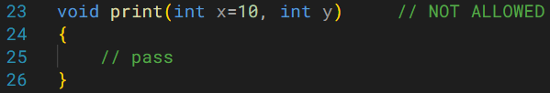
Another (Important) Syntactical Limitation
If a parameter is given a default argument…
… all subsequent parameters (to the right) must also be given default arguments.
y must also have a default argument.
OR
y should be on the left of x.

Slide 29
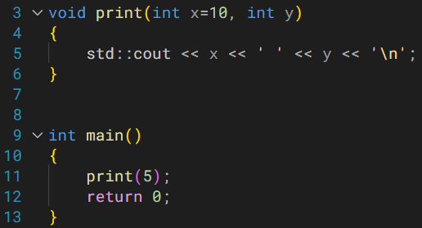

What will the following function call be interpreted as?

Slide 30
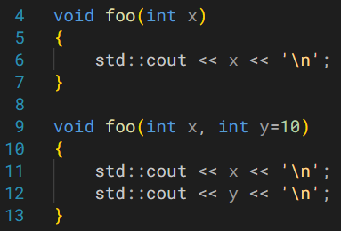
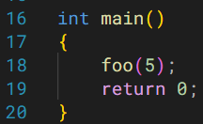
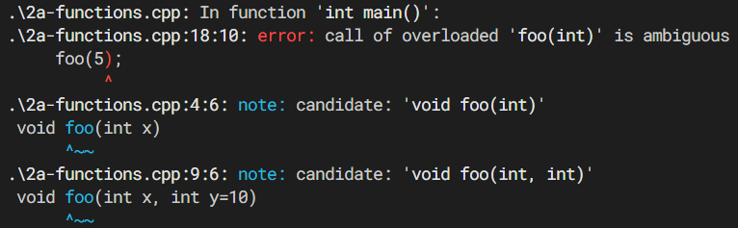
What will be the output of the following program?
Default arguments with function overloading
Notes:
Default arguments and function overloading.

Slide 31
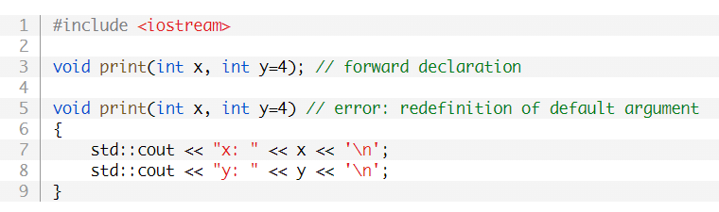
Default Arguments
The following will not work.

Slide 32
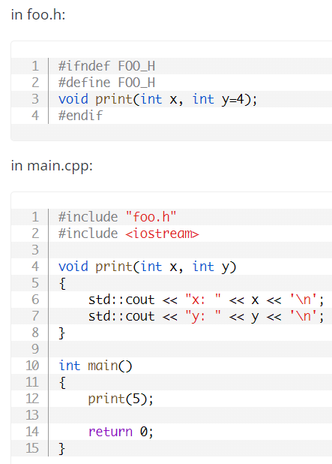
Put the default argument in either prototype or the definition.

Slide 33
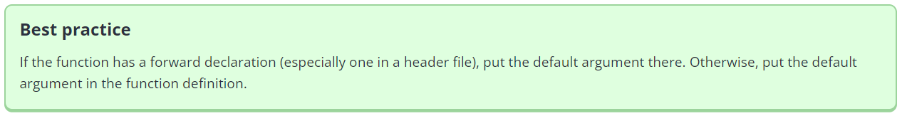

Slide 34
Static Variables
Code file.

